Slide 1


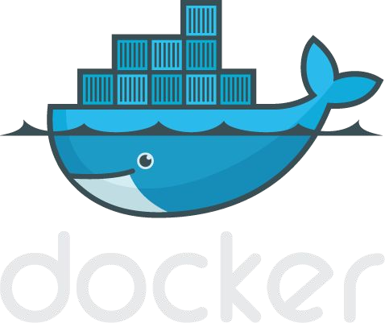

Slide 2

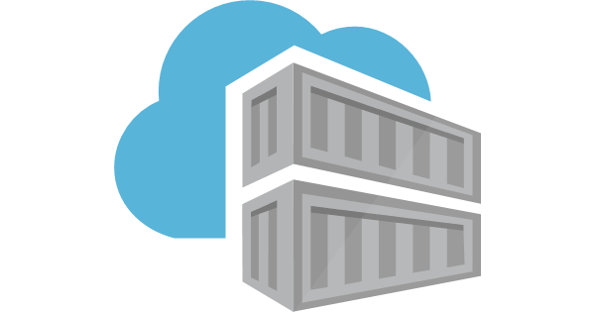
Network Virtualization
VMs require dedicated OS consuming CPU, RAM, resources; Every OS needs updates, licence, monitoring, etc;
VMs are slow to boot, moving VMs between Hypervisors(VmWare Workstation, ORACLE VirtualBox) and Cloud Platforms is an hard task;
Containers share the host’s OS; fast to start and ultra-portable
Docker is a software that creates, manages and orchestrates Containers
Kubernetes orchestrator of containerized apps. Deploy and management; It use Docket or containerd as default container runtime.

Slide 3
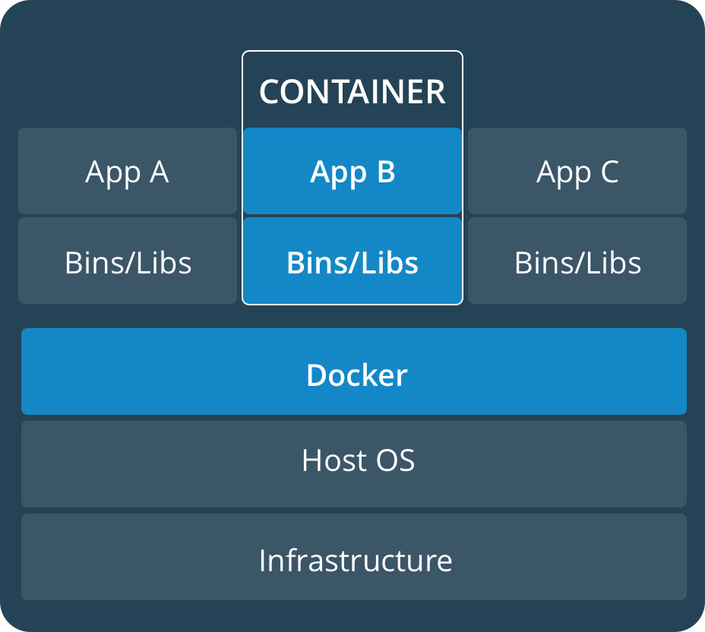
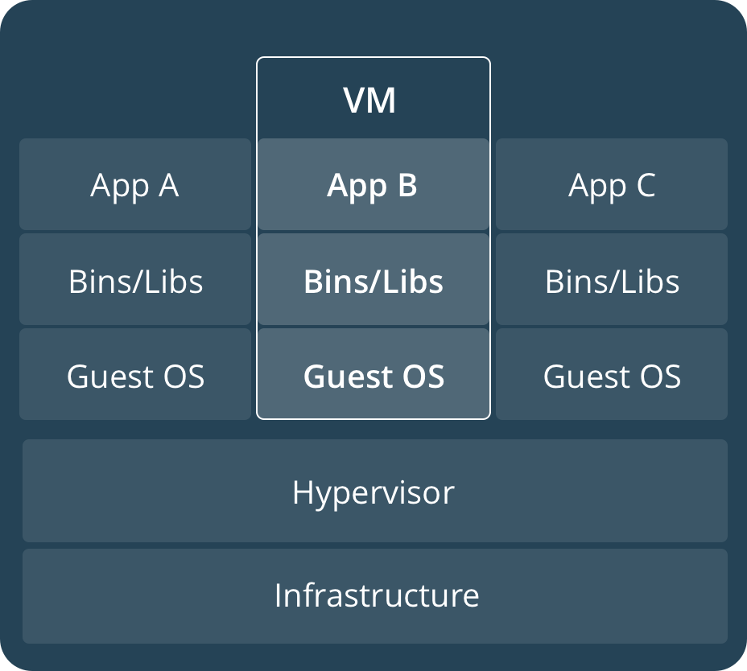
Containers vs VMs

Slide 4
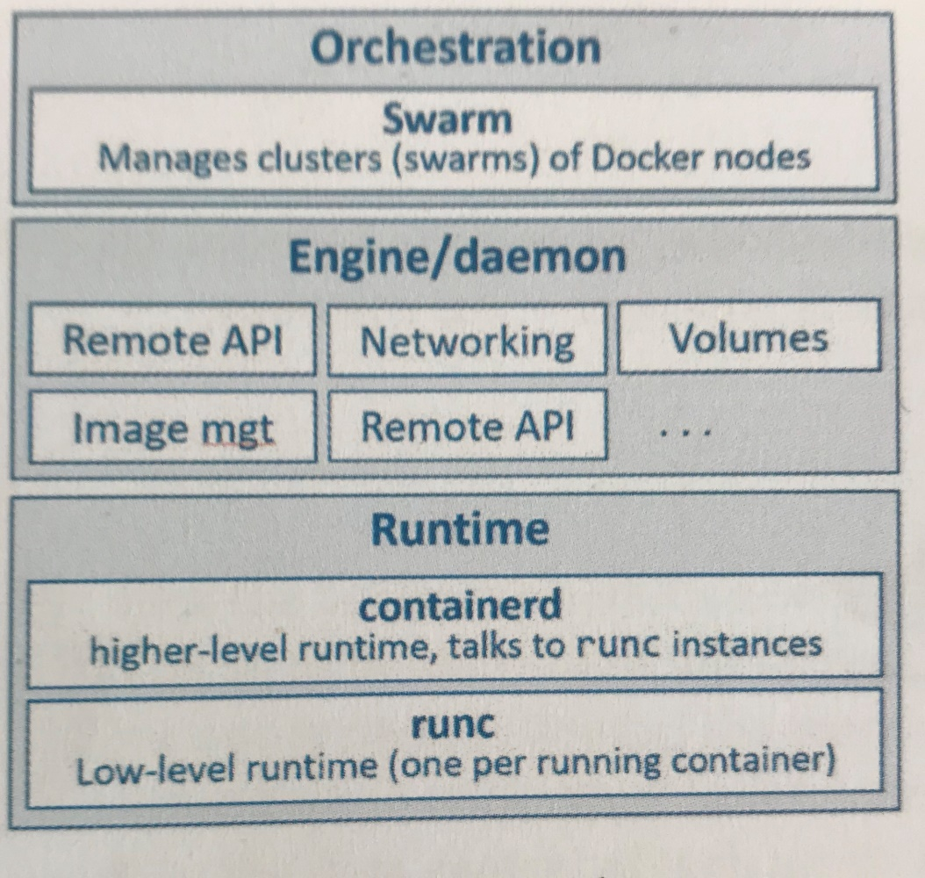
Docker Architecture
Runtime: Start and Stopp Containers;
Docker has tipically one containerd con trolling runc instances (Associated with each running container);
Containerd: lifecycle, image pull, creates network interface;
Deamon: manages images, volumes, networks, etc…
Orchestration: managing clusters of nodes running Docker, called Swarms. Kubernetes mostly used.

Slide 5




Some Docker vocabulary
Docker Image
The basis of a Docker container. Represents a full application
Docker Container
The standard unit in which the application service resides and executes
Docker Engine
Creates, ships and runs Docker containers deployable on a physical or virtual, host locally, in a datacenter or cloud service provider
Registry Service (Docker Hub(Public) or Docker Trusted Registry(Private))
Cloud or server based storage and distribution service for your images

Slide 6
Install and Test Docker
Installing Docker (Linux):
$ sudo apt-get update
$ sudo apt-get install docker.io
Some commands for testing the installation:
$ docker version
$ docker info
$docker system
Go to https://docs.docker.com/engine/reference/commandline/docker/ for a complete list of the docker commands.

Slide 7
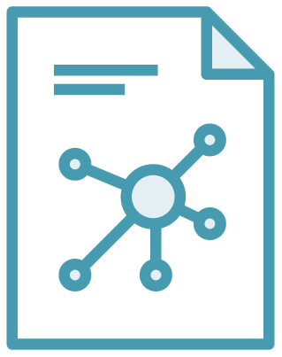

The Role of Images and Containers
Docker Image
Docker Container
Docker Images: Object containing OS filesystem, an app and all app dependencies;
An image is like a class in programming languages; as a virtual machine template is a stopped virtual machine, an image is a stopped container.

Slide 8
Docker Image
Howto list images present on your Docker host:
$ docker image ls
Howto pull images on your Docker host:
$ docker image pull ubuntu:latest
$ docker images
this ubuntu image is a stripped-down version of UBUNTU Linux filesystem, including a common set of Linux utilities
8

Slide 9
Howto run a Container with Docker
$ docker container run –it ubuntu:latest /bin/bash
-”-it” switch your shell into the terminal of the container;
-With this command tells Docker that we want the container to be based on the “ubuntu:latest” image;
-with ”/bin/bahs” We tell the Docker which process we want to run inside of the container (Bash Shell in this case);
We list now all the process running on the container typing the following command in the container:
root@kajhgvofwlhvg908364:/# ps –elf
Press Ctrl-PQ to exit the container without terminate it.

Slide 10
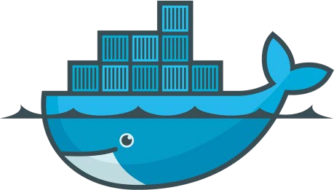
Some Commands
Howto see the running containers:
$docker container ls
Howto attach to a running container:
$docker container exec –it vigilant_borg bash
Howto STOP and REMOVE containers:
$docker stats vigilant_borg
$docker container stop vigilant_borg bash
$docker container rm vigilant_borg
$docker container ls -a

Slide 11
The Developer Perspective
We will now clone an app from the Git repository, inspect its Dockerfile, containerize it, and run it as a container:
$docker search nigelpoulton (search images in the repository named “nigelpoulton”)
$ git clone http://githob.com/nigelpoulton/psweb.git
$cd psweb
$ls –l
The psweb is a simple nodejs web app.
The Dockerfile tells the docker how to build an app and dependencies into a docker image.
$cat Dockerfile

Slide 12
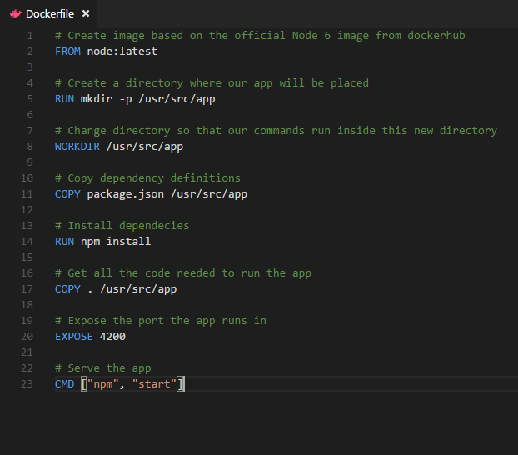
Docker file example

Slide 13
Build/run a container from the image
$docker image build –t test:latest . (the point at the end is important!)
$docker image ls
$docker container run –d –name web1 –publish 8080:8080 test:latest
- “-d” tell the docker to run the container in daemon mode, i.e. in background.
By typing localhost:8080 in the address line of a browser you will be able to reach the web app.

Slide 14
Howto visualize the webpage content
For visualise the content of the webpage use:
$curl localhost:8080
Or install the command line “w3m” browser:
$apk update
$apk add w3m
$w3m http://localhost:8080

Slide 15
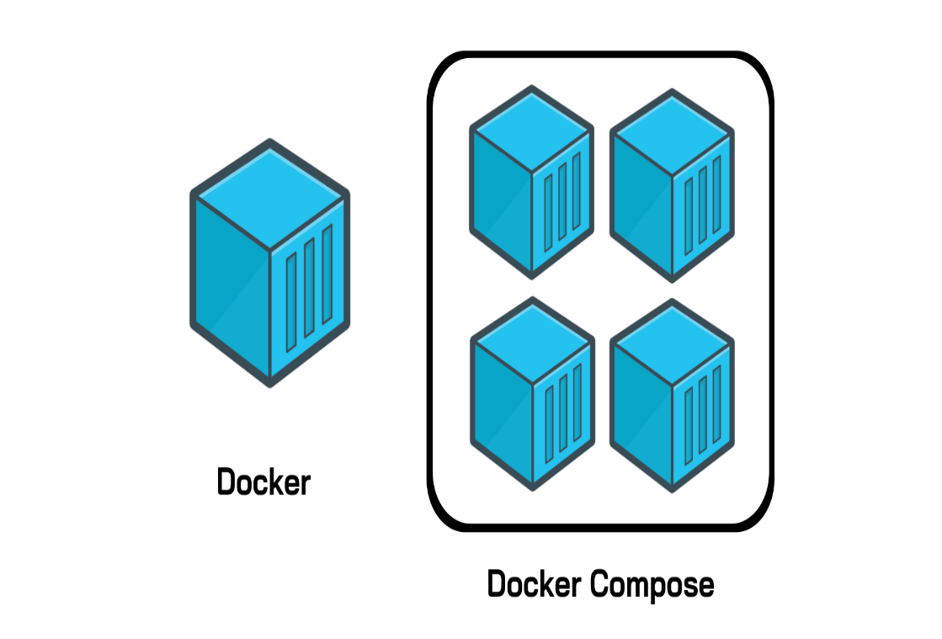
Docker Compose
Deploys and manages multi-container applications on Docker nodes running in a single-engine mode;
Apps are made of “microservices”, e.g.:
Web front-end,
Ordering,
Back-end database,
Logging,
Authentication,
…..

Slide 16




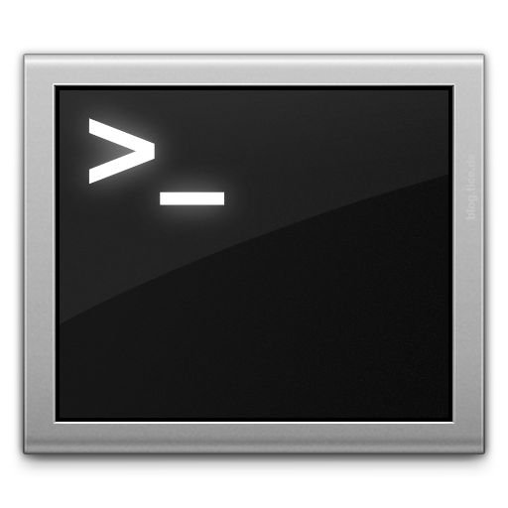







Docker Compose: Multi Container Applications
Build and run one container at a time
Manually connect containers together
Must be careful with dependencies and start up order
Define multi container app in compose.yml file
Single command to deploy entire app
Handles container dependencies
Works with Docker Swarm, Networking, Volumes, Universal Control Plane
49

Slide 17

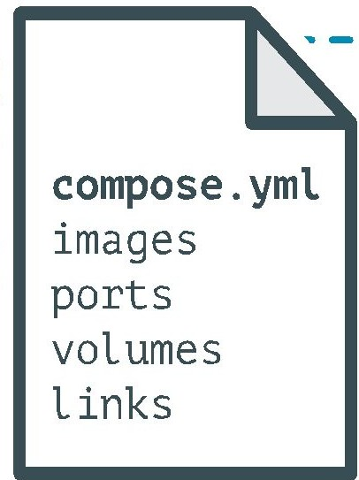
Docker Compose: Multi Container Applications
version: '2' # specify docker-compose version
# Define the services/containers to be run
services:
angular: # name of the first service
build: client # specify the directory of the Dockerfile
ports:
- "4200:4200" # specify port forewarding
express: #name of the second service
build: api # specify the directory of the Dockerfile
ports:
- "3977:3977" #specify ports forewarding
database: # name of the third service
image: mongo # specify image to build container from
ports:
- "27017:27017" # specify port forewarding

Slide 18
The Counter-App docker-compose application
$docker-compose –version
$git clone https://github.com/nigelpoulton/counter-app.git
$cd counter-app
$ls
$docker-compose up -d
Open an other terminal:
$docker image ls
App.py is the application code;
Docker-compose.yml describes how docker should build and deploy the app;
Dockerfile describes how to build the image for the web-fe service;
Requerements.txt list the Phython packages required for the app;
14

Slide 19
Some Commands
$docker-compose down
$docker-compose up –d
$docker-compose ps
$docker-compose top
$docker-compose stop
$docker-compose restart
$docker-compose rm
$docker container ls
$docker network ls
$docker volume ls
Run the app: browse to “localhost:5000”

Slide 20
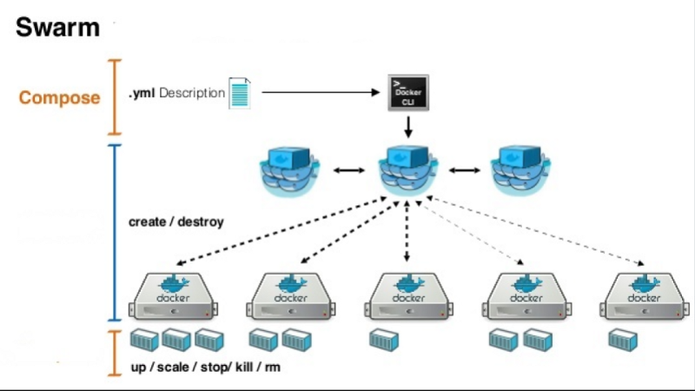
Orchestrating Containers with Docker Swarm

Slide 21
Docker Swarm
Docker Swarm is the official Docker orchestrator, and therefore comes built-in with Docker.
Docker Swarm’s architecture is very easy to understand. While Kubernetes has dozens of object types, Swarm has only a handful:
Manager — Manages the cluster, can have replicas for redundancy.
Worker node — A machine in a cluster that runs containers.
Service — A set of containers of the same type.
Container — The basic building block is a simple Docker container.

Slide 22
Docker Swarm
Initialize a new SWARM:
$docker swarm init –advertise-addr x.x.x.x:xxxx –listen-addr y.y.y.y:yyyy
$docker node ls
Join to a SWARM:
$docker swarm join-token worker
$docker swarm join-token manager
Lon on to the worker or the manager node and enter:
$docker swarm join –token XXXXXXXX --advertise-addr x.x.x.x:xxxx –listen-addr y.y.y.y:yyyy
List the nodes in the swarm from any of the manager node:
$docker node ls

Slide 23
Swarm Services
$docker service create –name web-fe –p 8080:8080 –replicas 5 nigelpoulton/pluralsight-docker-ci
The swarm runs a background reconciliation loop that constantly compares the observed state of the service with the desired state.
E.g. if a replica fail swarm will start a new web-fe replica to bring the observerd state back in line with the desired state.
$docker service ls
$docker service ps web-fe
$docker service inspect –pretty web-fe

Slide 24
Replicated vs global services
“--mode global” in the “docker service create” command
Replicated: deploys a desired number of replicas and distributes them as evenly as possible across the cluster;
Global: run a single replica on every node in the swarm.
Scale a service:
$docker service scale web-fe=10
$docker service ls
$docker service ps web-fe
Remove a service:
$docker service rm web-fe

Slide 25
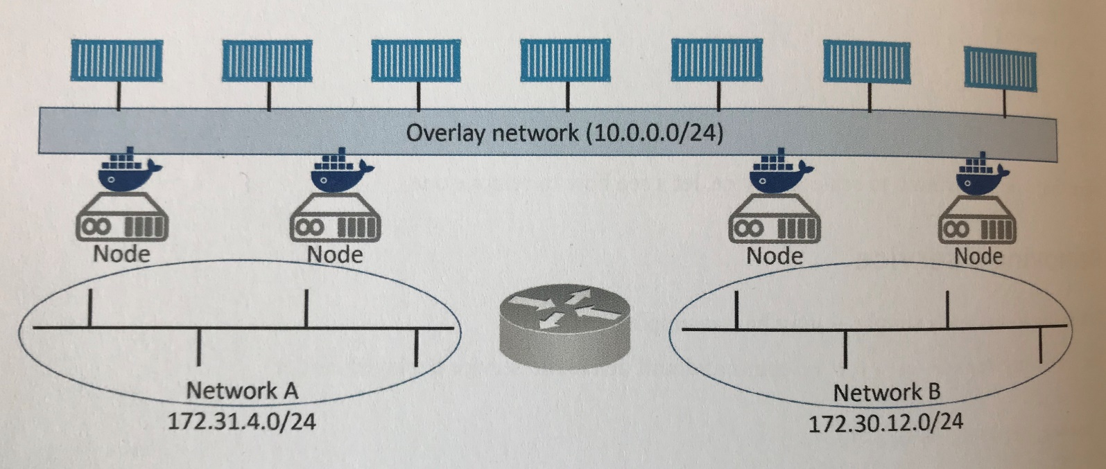
Rolling Updates
$docker network create –d overlay uber-net

Slide 26
Rolling Updates
$docker network ls
The uber-net network was successfully created with the swarm scope and is currently only visible on manager nodes in the swarm.
$docker service create –name uber-svr –network uber-net –p 80:80 –replicas 12 nigelpoulton/tu-demo:v1
$docker service ls
$docker service ps uber-svc
$docker service update –image nigelpoulton/tu-demo:v2 –update-parallelism 2 –update-delay 20s uber-svc

Slide 27

What is Docker Bridge Networking
Docker host
Docker host
Cntnr 1
Cntnr 2
Cntnr 3
Cntnr 4
Cntnr 5
Cntnr 6
Cntnr 7
bridgenet1
bridgenet2
bridgenet3
docker network create -d bridge --name bridgenet1

Slide 28


Docker Bridge Networking and Port Mapping
Docker host 1
Host port
Container port
Cntnr1
10.0.0.8
:80
$ docker container run -p 8080:80 ...
Bridge
172.14.3.55
:8080
L2/L3 physical network

Slide 29
Docker Volumes
Volumes mount a directory on the host into the container at a specific location
Can be used to share (and persist) data between containers
Directory persists after the container is deleted
Unless you explicitly delete it
Can be created in a Dockerfile or via CLI
$docker volume create myvol
$docker volume ls
$docker volume inspect myvol

Slide 30
Deploying apps with Docker Stacks
Doker Stacks let you:
define complex multi-service apps in a single declarative file;
Deploy the app and manage its entire lifecycle:
- initial deployment;
- desired state (defined in a Compose file);
- rolling updates/rollbacks;
- scaling;
- health checks;
The Compose file includes:
- the entire stack of microservices;
- the volumes;
- the networks;
- the secrets.
- the other infrastructure the app needs
Stacks are the top of the Docker application hierarchy. They build on top of services, which in turn build on top of containers.

Slide 31
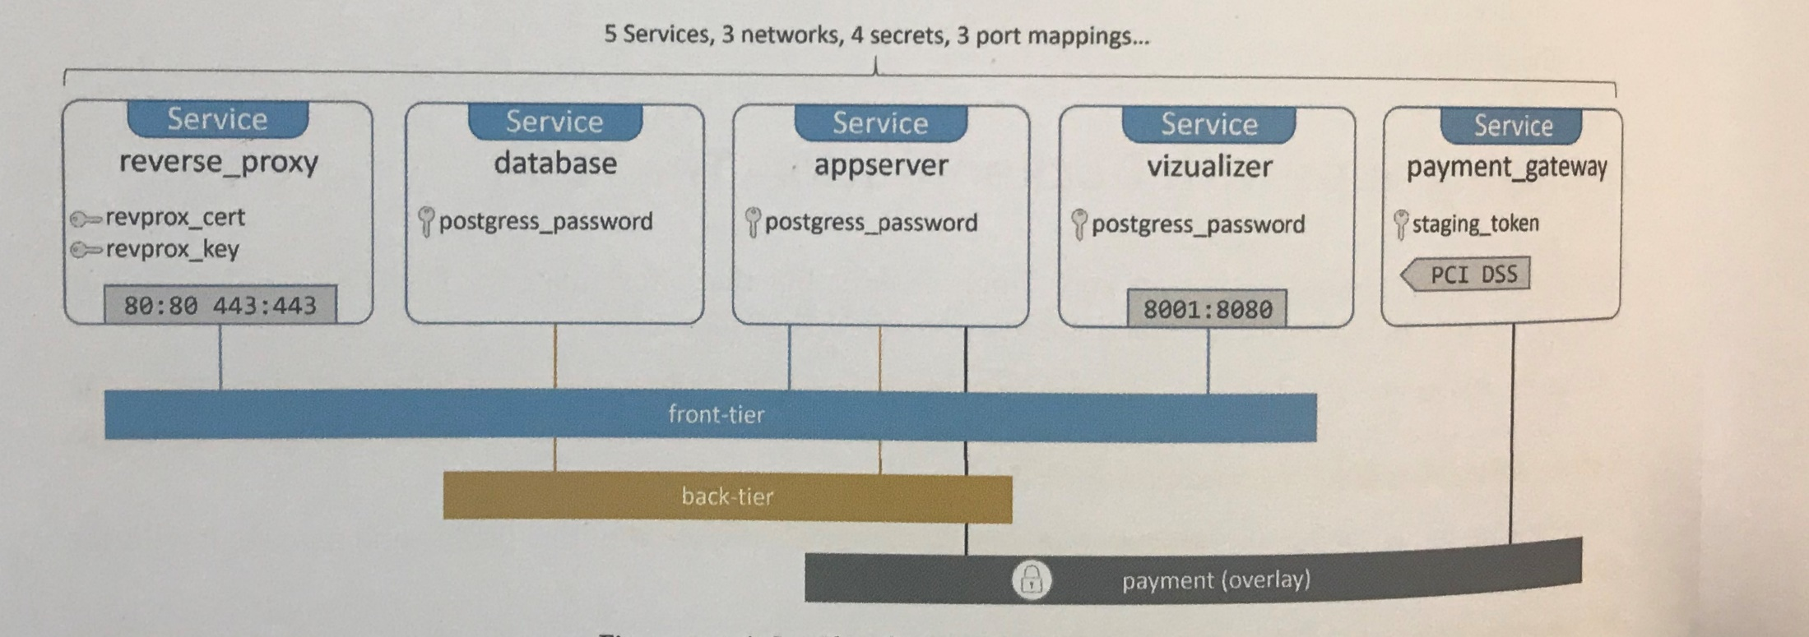
Overview of the sample App
The docker-stack.yml file defines te app and its requirements

Slide 32
$Git clone https://github.com/dockersamples/atsea-sample-shop-app.git
$cat docker-stack.yml
$docker swarm init
In worker 1:
$docker swarm join –token ehcgbkjsdghkjhgfkajgfk address:port
In worker 2:
$docker swarm join –token ehcgbkjsdghkjhgfkajgfk address:port
Verify configuration of the swarm:
$docker node ls
Configure the wrk-1 node so that it can run replicas for the payment_gateway service:
$docker node update –label-add pcidss=yes wrk-1
$docker node inspect wrk-1

Slide 33
Create a new key pair:
$openssl req –newkey rsa:4096 –nodes –sha256 –keyout domain.key –x509 –days 365 –out domain.crt
Create the secrets:
$docker secret create revprox_cert domain.crt
$docker secret create revprox_key domain.key
$docker secret create postgres_password domain.key
$echo staging | docker secret create staging_tocken –
Go to the app directory:
$cd atsea-sample-shop-app
Deploy the stack “seastack” (app):
$docker stack deploy –c docker-stack.yml seastack
$docker network ls $docker service ls
$docker stack ls $docker stack ps seastack $docker service logs seastack_reverse_proxy

Slide 34
Managing the app
Example:
increase the number of appserver replicas from 2 to 10;
Increase the stop grace period fro the visualizer service to 2 minutes.
Edit the docker-stack.yml file and update the following two values:
.services.appserver.deploy.replicas=10
.services.visualizer.stop_grace_period=2m
Save the file and redeploy the app:
$docker stack deploy –c docker-stack.yml seastack

